Slide 1
Operating System
Tim Pengampu MK Sistem Operasi
Universitas Dian Nuswantoro

Slide 2
Replacement Algorithm
When all processes in main memory are blocked, the OS must choose which process to replace
A process must be swapped out (to a Blocked-Suspend state) and be replaced by a new process or a process from the Ready-Suspend queue
We will discuss later such algorithms for memory management schemes using virtual memory

Slide 3
Relocation
Because of swapping and compaction, a process may occupy different main memory locations during its lifetime
Hence physical memory references by a process cannot be fixed
This problem is solved by distinguishing between logical address and physical address

Slide 4
Address Types
A physical address (absolute address) is a physical location in main memory
A logical address is a reference to a memory location independent of the physical structure/organization of memory
Compilers produce code in which all memory references are logical addresses
A relative address is an example of logical address in which the address is expressed as a location relative to some known point in the program (ex: the beginning)

Slide 5
Address Translation
Relative address is the most frequent type of logical address used in program modules (ie: executable files)
Such modules are loaded in main memory with all memory references in relative form
Physical addresses are calculated “on the fly” as the instructions are executed
For adequate performance, the translation from relative to physical address must by done by hardware

Slide 6
Simple example of hardware translation of addresses
When a process is assigned to the running state, a base register (in CPU) gets loaded with the starting physical address of the process
A bound register gets loaded with the process’s ending physical address
When a relative addresses is encountered, it is added with the content of the base register to obtain the physical address which is compared with the content of the bound register
This provides hardware protection: each process can only access memory within its process image

Slide 7
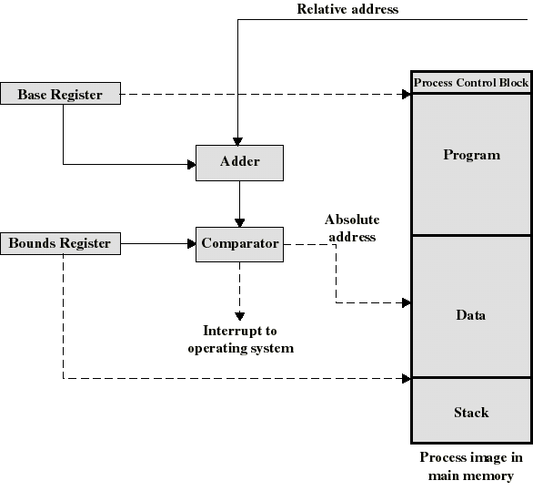
Example Hardware for Address Translation

Slide 8
Virtual Memory
Swapping allows us to allocate memory to processes when they need it. But what happens when we do not have enough memory ?
In the past, overlays were used
Responsibility of the programmer
Program split into logical sections (called overlays)
Only one overlay would be loaded into memory at a time
Meant that more programs could be running than would be the case if the complete program had to be in memory
Downsides
Programmer had to take responsibility for splitting the program into logical sections
Time consuming, boring and open to error

Slide 9
Virtual Memory
Virtual Memory
Idea is that that the computer is able to run programs even if the amount of physical memory is not sufficient to allow the program and all its data to reside in memory at the same time
At the most basic level we can run a 500K program on a 256K machine
We can also use virtual memory in a multiprogramming environment. We can run twelve programs in a machine that could, without virtual memory, only run four

Slide 10
Virtual Memory
Physical Memory
Swapping Disk
Data Structure
Frame Page
Table Page
Empty Frame Page List
Modified Empty Frame Page List
Replacement Algorithm Table
Swap Area
User Page
Table Page
Empty Frame Page List
Swap Area
Modified Empty Frame Page List
Replacement Algorithm Table

Slide 11
Paging System
In a computer system that does not support virtual memory, when a program generates a memory address it is placed directly on the memory bus which causes the requested memory location to be access
On a computer that supports virtual memory, the address generated by a program goes via a Memory Management Unit (MMU). This unit maps virtual addresses to physical addresses

Slide 12
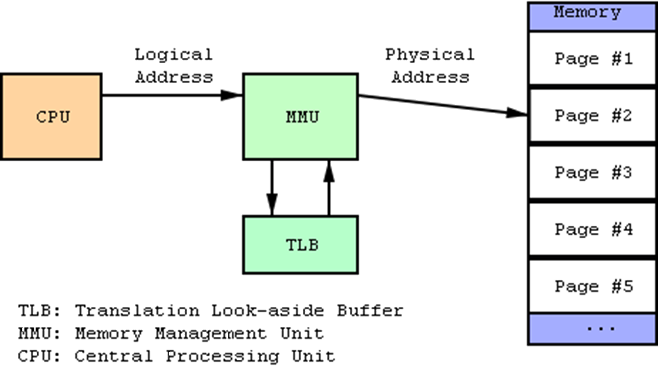

Slide 13
Example
Assume a program tries to access address 8192
This address is sent to the MMU
The MMU recognize that this address falls in virtual page 2 (assume pages start at zero)
The MMU looks at its page mapping and sees that page 2 maps to physical page 6
The MMU translates 8192 to the relevant address in physical page 6 (this being 24576)
This address is output by the MMU and the memory board simply sees a request for address 24576. It does not know that the MMU has intervened. The memory board simply sees a request for a particular location, which it honors.

Slide 14
Virtual Address Space
Physical Memory Addresses
0K – 4K
2
0K – 4K
4K – 8K
1
4K – 8K
8K – 12K
6
8K – 12K
12K – 16K
0
12K – 16K
16K – 20K
4
16K – 20K
20K – 24K
3
20K – 24K
24K – 28K
X
24K – 28K
28K – 32K
X
28K – 32K
32K – 36K
X
Page Frame
36K – 40K
5
40K – 44K
X
44K – 48K
7
48K – 52K
X
52K – 56K
X
Virtual Page
56K – 60K
X
60K – 64K
X

Slide 15
If a virtual memory address is not on a page boundary (as in the above example) then the MMU also has to calculate an offset (in fact, there is always an offset – in the above example it was zero)
We have not really achieved anything yet as, in effect, we have eight virtual pages which do not map to a physical page
Each virtual page will have a present/absent bit which indicates if the virtual page is mapped to a physical page

Slide 16
What happens if we try to use an unmapped page? For example, the program tries to access address 24576 (i.e. 24K)
The MMU will notice that the page is unmapped and will cause a trap to the operating system
This trap is called a page fault
The operating system will decide to evict one of the currently mapped pages and use that for the page that has just been referenced
The page that has just been referenced is copied (from disc) to the virtual page that has just been freed.
The virtual page frames are updated.
The trapped instruction is restarted.

Slide 17
Example (trying to access address 24576)
The MMU would cause a trap to the operating system as the virtual page is not mapped to a physical location
A virtual page that is mapped is elected for eviction (we’ll assume that page 11 is nominated)
Virtual page 11 is mark as unmapped (i.e. the present/absent bit is changed)
Physical page 7 is written to disc (we’ll assume for now that this needs to be done). That is the physical page that virtual page 11 maps onto
Virtual page 6 is loaded to physical address 28672 (28K)
The entry for virtual page 6 is changed so that the present/absent bit is changed. Also the ‘X’ is replaced by a ‘7’ so that it points to the correct physical page
When the trapped instruction is re-executed it will now work correctly

Slide 18
How the MMU Works
Incoming Address
0
1
0
1
0
0
0
1
0
1
0
1
0
0
1
0
0
010
1
Present/Absent Bits
1
001
1
2
110
1
3
000
1
4
100
1
5
011
1
6
000
0
7
000
0
8
000
0
9
101
1
10
000
0
11
111
1
12
000
0
13
000
0
14
000
0
15
000
0
0
1
1
0
0
0
1
0
1
0
1
0
0
1
0
Outgoing Address

Slide 19
Page Replacement Algorithms
Want lowest page-fault rate.
Evaluate algorithm by running it on a particular string of memory references (reference string) and computing the number of page faults and page replacements on that string.
In all our examples, we use a few recurring reference strings.

Slide 20
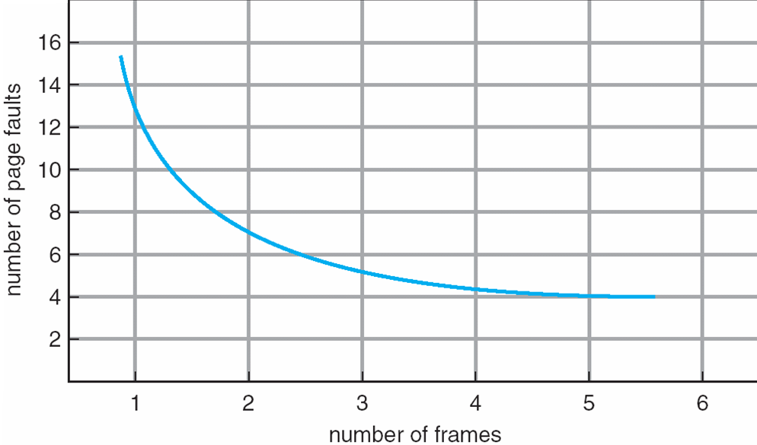
Graph of Page Faults vs. the Number of Frames

Slide 21
But, if we cannot implement the algorithm then why bother discussing it ?
In fact, we can implement it, but only after running the program to see which pages we should evict at what point
We can then use this as a measure to see how other algorithms perform against this ideal.

Slide 22
Page Replacement Algorithms
Choose a mapped page at random
Likely to lead to degraded system performance
Page chosen has a reasonable chance of being a page that will need to be used again in the near future
The Optimal Page Replacement Algorithm
Evict the page that we will not use for the longest period
Problem is we cannot look into the future and decide which page to evict
But, if we could, we could implement an optimal algorithm

Slide 23
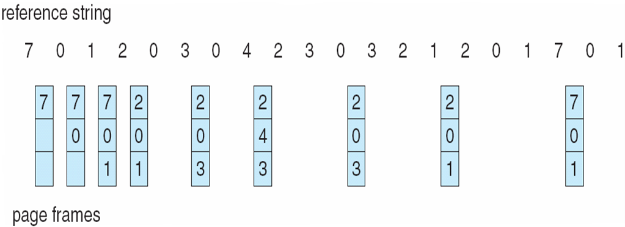
Optimal Page Replacement

Slide 24
Optimal Algorithm
Reference string : 1, 2, 3, 4, 1, 2, 5, 1, 2, 3, 4, 5
4 frames example
How do you know future use ? You don’t !
Used for measuring how well your algorithm performs.
1
4
2
6 page faults
3
4
5

Slide 25
The Not-Recently-Used Page Replacement Algorithm
Make use of the referenced and modified bits
When a process starts all its page entries are marked as not in memory
When a page is referenced a page fault will occur
The R (reference) bit is set and the page table entry modified to point to the correct page
The page is set to read only. If the page is later written to the M (modified) bit is set and the page is changed so that it is read/write

Slide 26
Updating the flags in this way allows a simple paging algorithm to be built
When a process is started up all R and M bits are cleared set to zero
Periodically (e.g. on each clock interrupt) the R bit is cleared (allows us to recognise which pages have been recently referenced)

Slide 27
When a page fault occurs (so that a page needs to be evicted), the pages are inspected and divided into four categories based on their R and M bits
Class 0 : Not Referenced, Not Modified
Class 1 : Not Referenced, Modified
Class 2 : Referenced, Not Modified
Class 3 : Referenced, Modified
The NRU algorithm removes a page at random from the lowest numbered class that has entries in it
Not optimal algorithm, NRU often provides adequate performance and is easy to understand and implement

Slide 28
The First-In, First-Out (FIFO) Page Replacement Algorithm
Maintains a linked list, with new pages being added to the end of the list
When a page fault occurs, the page at the head of the list (the oldest page) is evicted
Simple to understand and implement but does not lead to good performance as a heavily used page is just as likely to be evicted as a lightly used page.

Slide 29
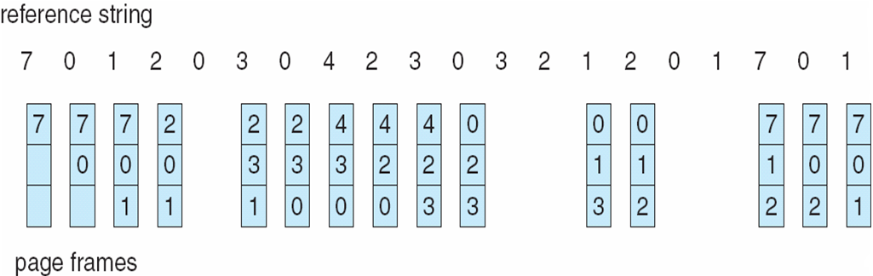
FIFO Page Replacement Example

Slide 30
First-In-First-Out (FIFO) Algorithm
Reference string: 1, 2, 3, 4, 1, 2, 5, 1, 2, 3, 4, 5
3 frames (3 pages can be in memory at a time per process) :
4 frames :
FIFO Replacement manifests Belady’s Anomaly:
more frames ⇒ more page faults
1
1
4
5
2
2
1
3
9 page faults
3
3
2
4
1
1
5
4
2
2
1
5
10 page faults
3
3
2
4
4
3

Slide 31
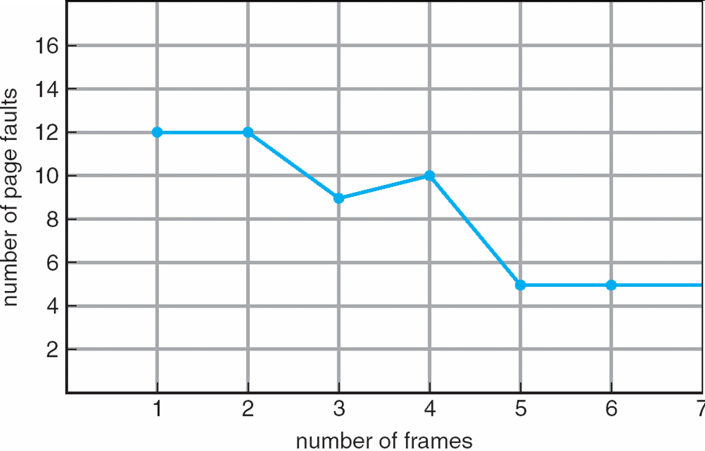
FIFO Illustrating Belady’s Anomaly

Slide 32
The Second Chance Page Replacement Algorithm
Modification of the FIFO algorithm
When a page fault occurs if the page at the front of the linked list has not been referenced it is evicted.
If its reference bit is set, then it is placed at the end of the linked list and its reference bit reset
In the worst case, SC, operates the same as FIFO

Slide 33
The Clock Page Replacement Algorithm
The clock page (CP) algorithm differs from SC only in its implementation
SC suffers in the amount of time it has to devote to the maintenance of the linked list
More efficient to hold the pages in a circular list and move the pointer rather than move the pages from the head of the list to the end of the list.

Slide 34
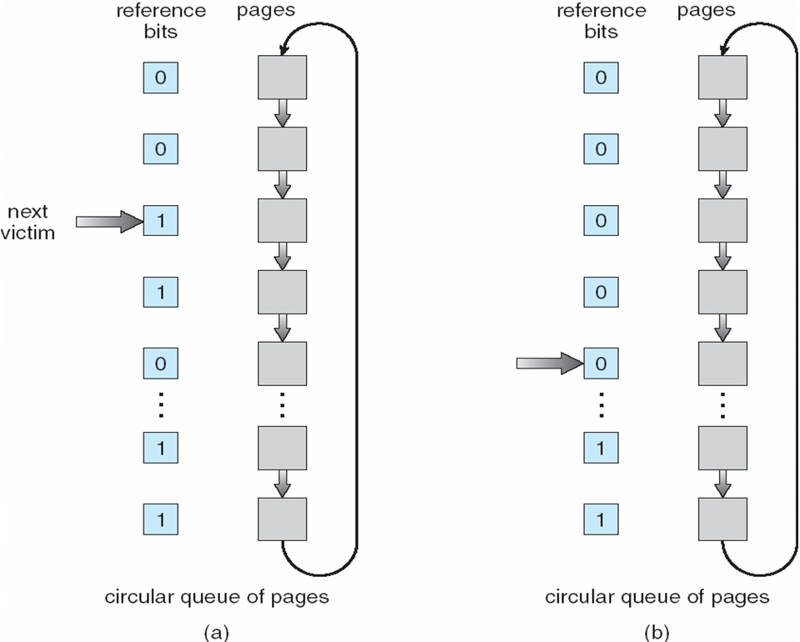
Clock Page-Replacement Algorithm

Slide 35
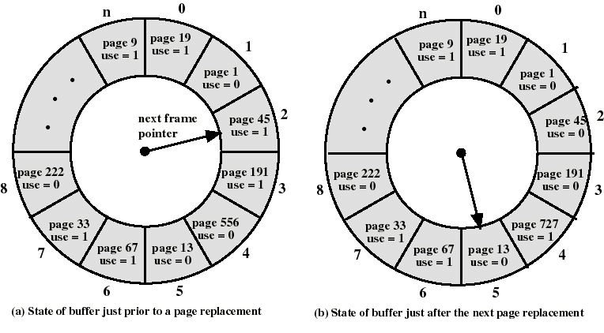
The Clock Policy: Another Example

Slide 36
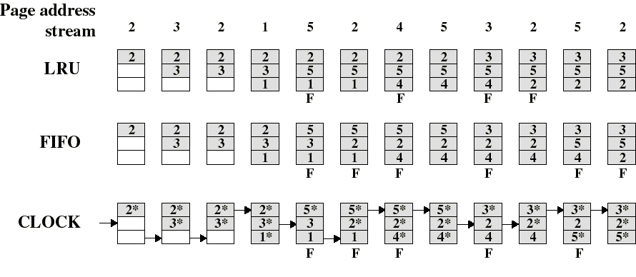
Comparison of Clock with FIFO and LRU
Asterisk indicates that the corresponding use bit is set to 1.
The arrow indicates the current position of the pointer.
Note that the clock policy is adept at protecting frames 2 and 5 from replacement.

Slide 37
Numerical experiments tend to show that performance of Clock is close to that of LRU.
Experiments have been performed when the number of frames allocated to each process is fixed and when pages local to the page-fault process are considered for replacement:
When few (6 to 8) frames are allocated per process, there is almost a factor of 2 of page faults between LRU and FIFO.
This factor reduces close to 1 when several (more than 12) frames are allocated. (But then more main memory is needed to support the same level of multiprogramming).

Slide 38
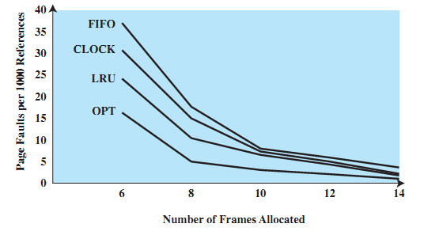
Fixed-Allocation, Local Page Replacement

Slide 39
The Least Recently Used (LRU) Page Replacement Algorithm
Approximate an optimal algorithm by keeping track of when a page was last used (page that has not been referenced for the longest time)
If a page has recently been used then it is likely that it will be used again in the near future
Therefore, if we evict the page that has not been used for the longest amount of time we can implement a least recently used (LRU) algorithm
Whilst this algorithm can be implemented it is not cheap as we need to maintain a linked list of pages which are sorted in the order in which they have been used

Slide 40
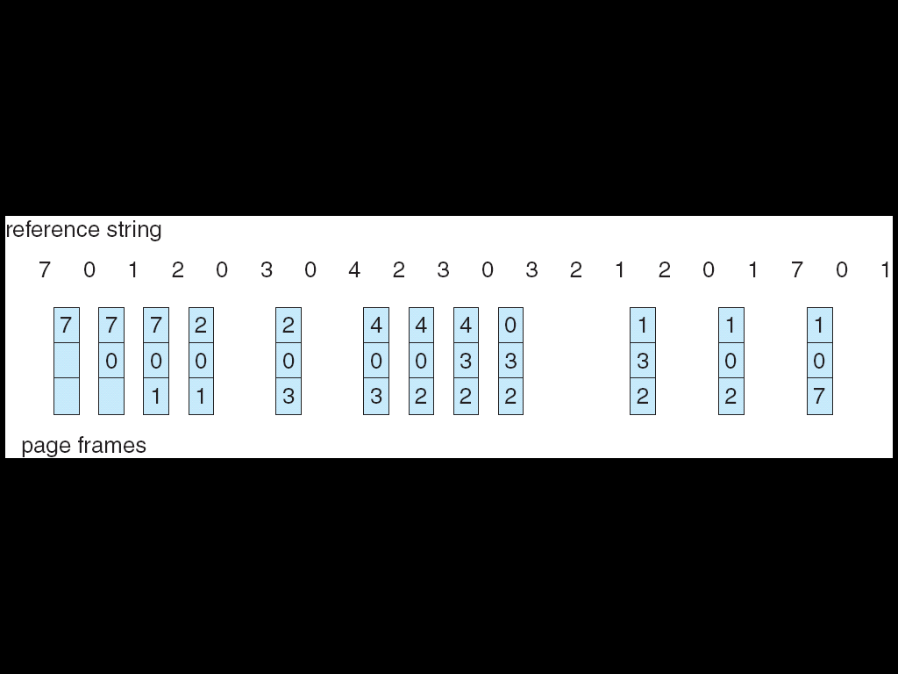
LRU Page Replacement

Slide 41
Least Recently Used (LRU) Algorithm
Reference string: 1, 2, 3, 4, 1, 2, 5, 1, 2, 3, 4, 5
1
1
1
1
5
2
2
2
2
2
8 page faults
3
5
5
4
4
4
4
3
3
3

Slide 42
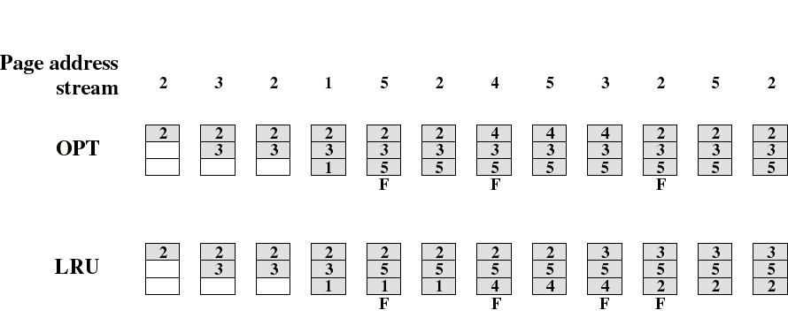
Comparison of OPT with LRU
Example: A process of 5 pages with an OS that fixes the resident set size to 3.

Slide 43

Comparison of FIFO with LRU
LRU recognizes that pages 2 and 5 are referenced more frequently than others but FIFO does not.

Slide 45
We can implement the algorithm in hardware
The hardware is equipped with a counter (typically 64 bits). After each instruction the counter is incremented
Each page table entry has a field large enough to accommodate the counter
Every time the page is referenced the value from the counter is copied to the page table field
When a page fault occurs the operating system inspects all the page table entries and selects the page with the lowest counter
This is the page that is evicted as it has not been referenced for the longest time

Slide 46
Another hardware implementation of the LRU algorithm is given below.
If we have n page table entries a matrix of n x n bits , initially all zero, is maintained
When a page frame, k, is referenced then all the bits of the k row are set to one and all the bits of the k column are set to zero
At any time the row with the lowest binary value is the row that is the least recently used (where row number = page frame number)
The next lowest entry is the next recently used; and so on.

Slide 47
If we have four page frames and access them as follows
0 1 2 3 2 1 0 3 2 3
the algorithm operates as follows
Page
0 1 2 3
Page
0 1 2 3
Page
0 1 2 3
Page
0 1 2 3
Page
0 1 2 3
0
1
2
3
0
1
1
1
0
0
1
1
0
0
0
1
0
0
0
0
0
0
0
0
0
0
0
0
1
0
1
1
1
0
0
1
1
0
0
0
1
0
0
0
0
0
0
0
0
0
0
0
1
1
0
1
1
1
0
0
1
1
0
1
0
0
0
0
0
0
0
0
0
0
0
0
1
1
1
0
1
1
0
0
(a)
0 1 2 3
(b)
0 1 2 3
(c)
0 1 2 3
(d)
0 1 2 3
(e)
0 1 2 3
0
1
2
3
0
0
0
0
0
1
1
1
0
1
1
0
0
1
0
0
0
1
0
0
1
0
1
1
0
0
1
1
0
0
1
0
0
0
0
0
0
0
0
0
1
0
0
1
0
0
0
1
0
0
0
0
1
1
0
1
1
1
0
0
1
0
0
0
0
0
0
0
1
1
1
0
1
1
0
0
1
1
1
0
(f)
(g)
(h)
(i)
(j)

Slide 48
LRU in Software
We cannot, as OS writers, implement LRU in hardware if the hardware does not provide the facilities
We can implement a similar algorithm in software
Not Frequently Used – NFU associates a counter with each page
This counter is initially zero but at each clock interrupt the operating system scans all the pages and adds the R bit to the counter
When a page fault occurs the page with the lowest counter is selected for replacement.

Slide 49
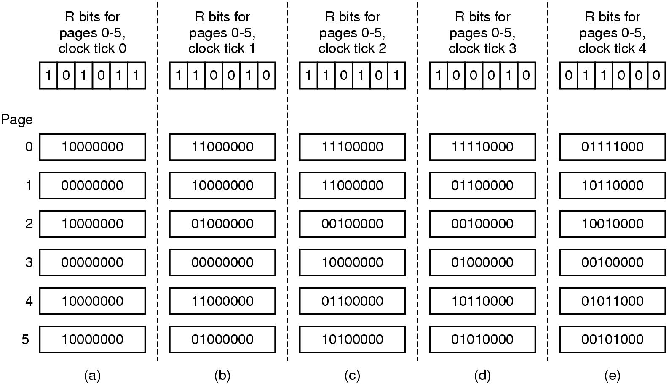
Problem with NFU is that it never forgets anything
To alleviate this problem we can make a modification to NFU so that it closely simulates NRU
The counters are shifted right one bit before the R bit is added.
The R bit is added to the leftmost bit rather than the rightmost bit.
This implements a system of aging.
When a page fault occurs, the counter with the lowest value is removed

Slide 50
Exercise (Page Replacement)
Page Reference String : 1, 2, 3, 4, 2, 1, 5, 6, 2, 1, 2, 3, 7, 6, 3, 2, 1, 2, 3, 6
How many Page Fault will occur using LRU, FIFO and Optimal Page Replacement ?

Slide 51
Segmentation
Each program is subdivided into blocks of non-equal size called segments
When a process gets loaded into main memory, its different segments can be located anywhere
Each segment is fully packed with instructs/data: no internal fragmentation
There is external fragmentation; it is reduced when using small segments

Slide 52
In contrast with paging, segmentation is visible to the programmer
provided as a convenience to organize logically programs (ex: data in one segment, code in another segment)
must be aware of segment size limit
The OS maintains a segment table for each process. Each entry contains :
the starting physical addresses of that segment.
the length of that segment (for protection)

Slide 53
Segmentation and Paging Comparison
Segmentation requires more complicated hardware for address translation
Segmentation suffers from external fragmentation
Paging only yield a small internal fragmentation
Segmentation is visible to the programmer whereas paging is transparent
Segmentation can be viewed as commodity offered to the programmer to organize logically a program into segments and using different kinds of protection (ex: execute-only for code but read-write for data)
for this we need to use protection bits in segment table entries

Slide 54
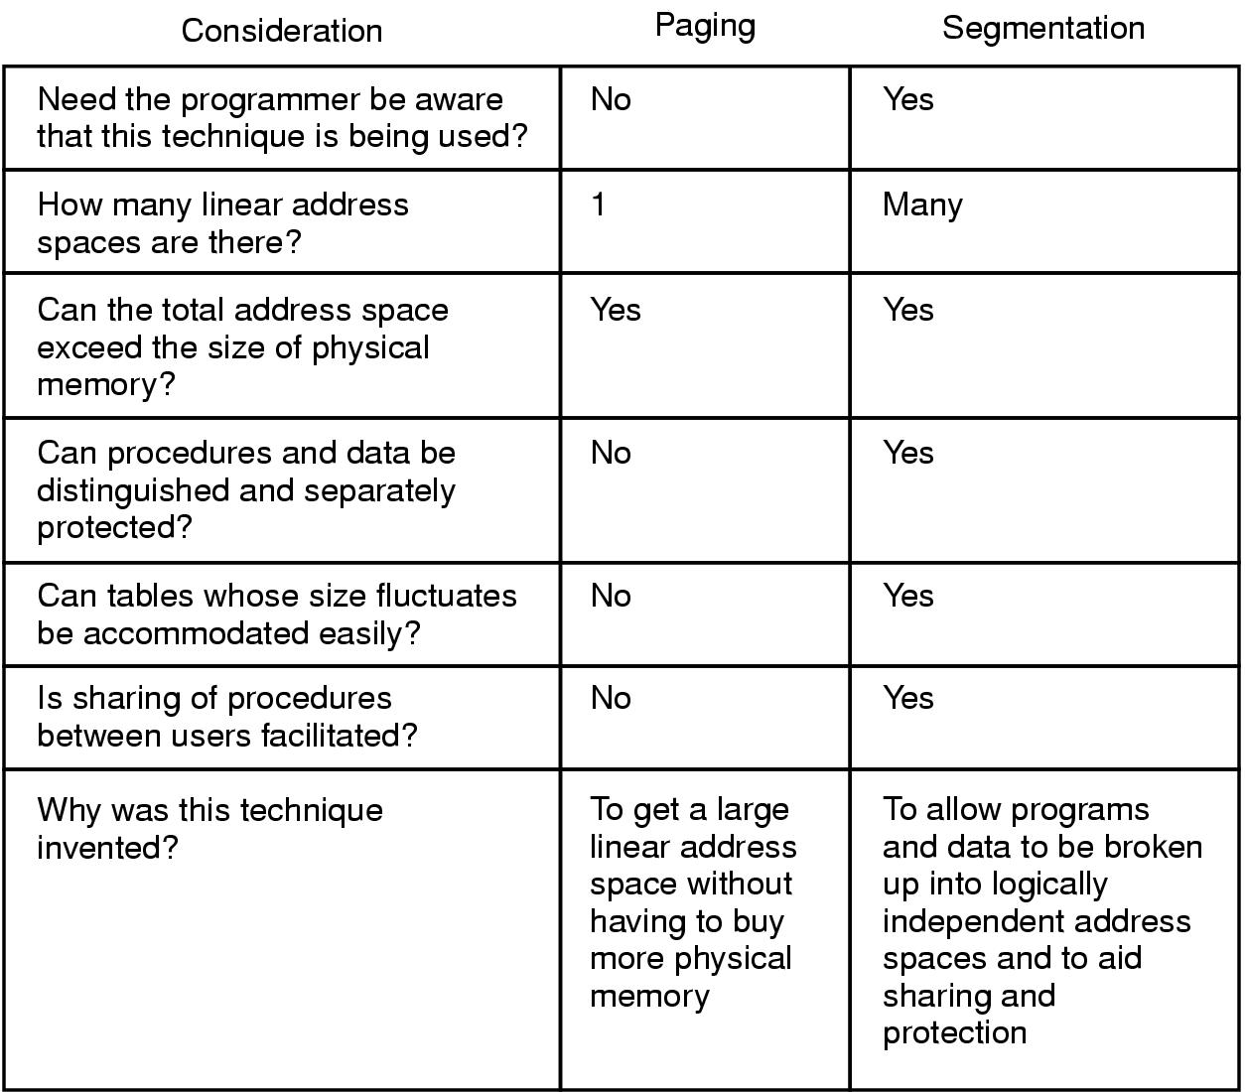

Slide 55
Combined Segmentation and Paging
To combine their advantages, some OSs page the segments.
Several combinations exist – assume each process has:
one segment table.
several page tables: one page table per segment.
The virtual address consists of:
a segment number: used to index the segment table who’s entry gives the starting address of the page table for that segment.
a page number: used to index that page table to obtain the corresponding frame number.
an offset: used to locate the word within the frame.

Slide 56
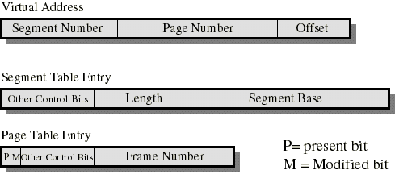
Simple Combined Segmentation and Paging
The Segment Base is the physical address of the page table of that segment.
Present/modified bits are present only in page table entry.
Protection and sharing info most naturally resides in segment table entry.
Ex: a read-only/read-write bit, a kernel/user bit...

Slide 57

Any Question ?
Anything to discuss ?

